Slide 1
MODULE 3: Radio Access Technologies in 5G
Introduction to Radio Access Technologies
New Radio (NR) Interface: Overview and Features
New Radio (NR) Interface: Key Technologies
Massive MIMO in 5G
Beamforming in 5G
Beamforming Types
Small Cells in 5G
HetNets in 5G
Millimeter wave Communication;

Slide 2
MODULE 3: Radio Access Technologies in 5G
M3 S1 & S2
Introduction to Radio Access Technologies
New Radio (NR) Interface: Overview and Features

Slide 3
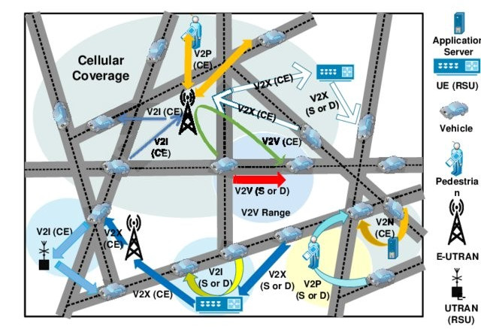

Introduction to Radio Access Technologies
What is radio access network?
A radio access network (RAN) is a major component of a wireless telecommunications system that connects individual devices to other parts of a network through a radio link.
The RAN links user equipment, such as a cellphone, computer or any remotely controlled machine, over a fiber or wireless backhaul connection.
That link goes to the core network, which manages subscriber information, location and more.

Slide 4
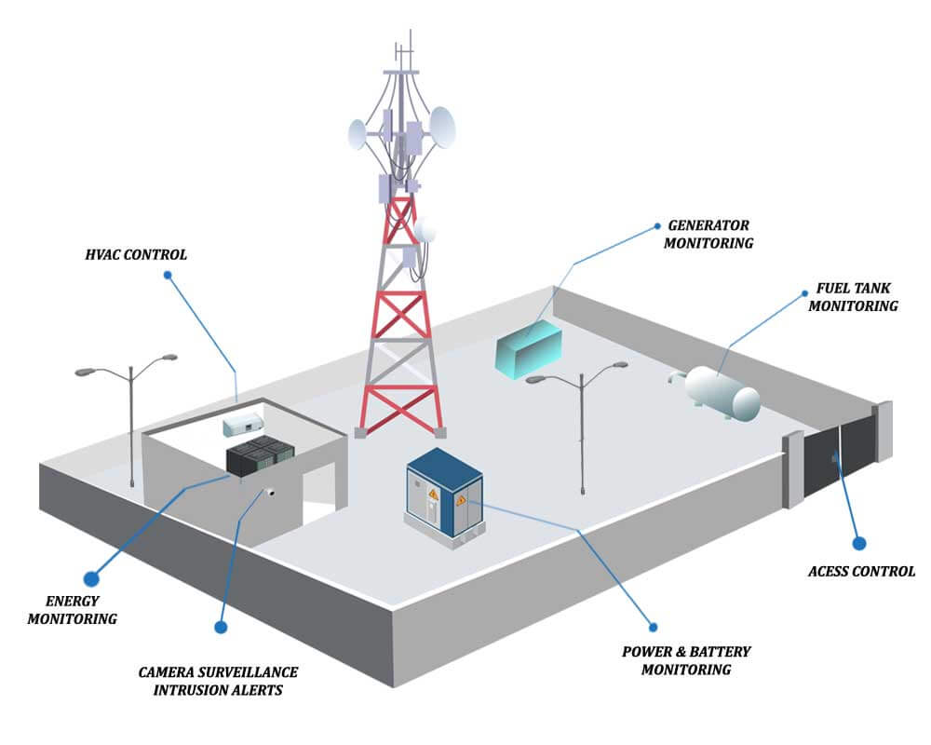
Introduction to Radio Access Technologies
What is radio access network?
The RAN, which is sometimes also called the access network, is the radio element of the cellular network.
A cellular network is made up of land areas called cells.
A cell is served by at least one radio transceiver, although the standard is typically three for cell sites.

Slide 5

Introduction to Radio Access Technologies
What is radio access network?
RANs have evolved from the first generation (1G) to the fifth generation (5G) of cellular networking.
With the development of fourth generation (4G) technology in the 2000s, the 3rd Generation Partnership Project introduced Long-Term Evolution (LTE) RAN, and the radio access network and the core network changed significantly.
With 4G, system connectivity for the first time was based on the Internet Protocol (IP), replacing the previous circuit-based networks.

Slide 6
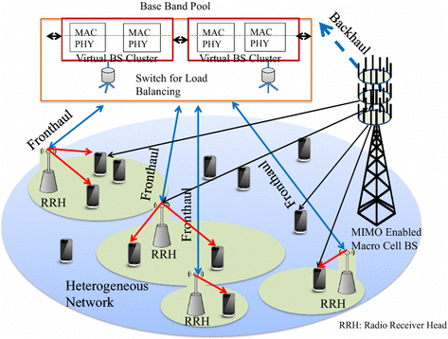
Introduction to Radio Access Technologies
What is radio access network?
Now, with LTE Advanced and 5G, improvements are coming in the form of centralized RAN, also called cloud RAN (C-RAN), and multiple antenna arrays, such as multiple input, multiple output (MIMO).

Slide 7
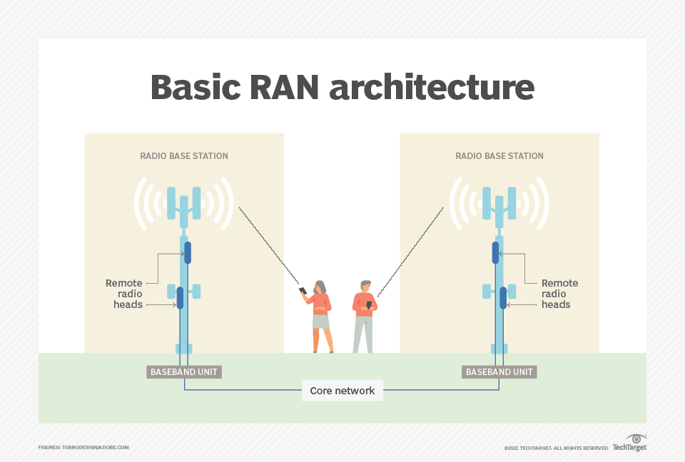
Introduction to Radio Access Technologies
What is radio access network?
Since the first cellular networks were introduced, the capabilities of RAN have expanded to include voice calls, text messaging, and video and audio streaming.
The types of user equipment using these networks have drastically increased, including all types of vehicles, drones and internet of things devices.

Slide 8
Introduction to Radio Access Technologies
What components make up a RAN?
RAN components include base stations and antennas that cover a specific region, depending on their capacity.
Silicon chips in both the core network and the user equipment provide RAN functionality.

Slide 9
Introduction to Radio Access Technologies
What components make up a RAN?
A RAN is made up of three essential elements:
Antennas convert electrical signals into radio waves.
Radios transform digital information into signals that can be sent wirelessly and ensure that transmissions are in the correct frequency bands with the right power levels.
Baseband units (BBUs) provide a set of signal processing functions that make wireless communication possible. Traditional baseband uses custom electronics combined with multiple lines of code to enable wireless communication, typically using the licensed radio spectrum. BBU processing detects errors, secures the wireless signal and ensures that wireless resources are used effectively.

Slide 10
Introduction to Radio Access Technologies
What components make up a RAN?
A RAN is made up of three essential elements:
Antennas convert electrical signals into radio waves.
Radios transform digital information into signals that can be sent wirelessly and ensure that transmissions are in the correct frequency bands with the right power levels.
Baseband units (BBUs) provide a set of signal processing functions that make wireless communication possible. Traditional baseband uses custom electronics combined with multiple lines of code to enable wireless communication, typically using the licensed radio spectrum. BBU processing detects errors, secures the wireless signal and ensures that wireless resources are used effectively.

Slide 11
Introduction to Radio Access Technologies
What is RAN in 5G?
The 5G New Radio (5G NR) standard is the latest radio interface and radio access technology for 5G cellular technology.
The interface supports multiple frequency bands, including sub-6 gigahertz bands and millimeter wave (mmWave) bands, such as 24 GHz, 28 GHz and higher.
The mmWave bands offer 1+ gigabits per second download speeds, but they have reduced ranges compared to sub-6 GHz services.

Slide 12


New Radio (NR) Interface: Overview and Features
San Diego, CA
March 24th, 2022
3GPP Release 17:
Completing the first phase of the 5G evolution
To bring new system capabilities and expand 5G
to new devices, applications, and deployment

Slide 13
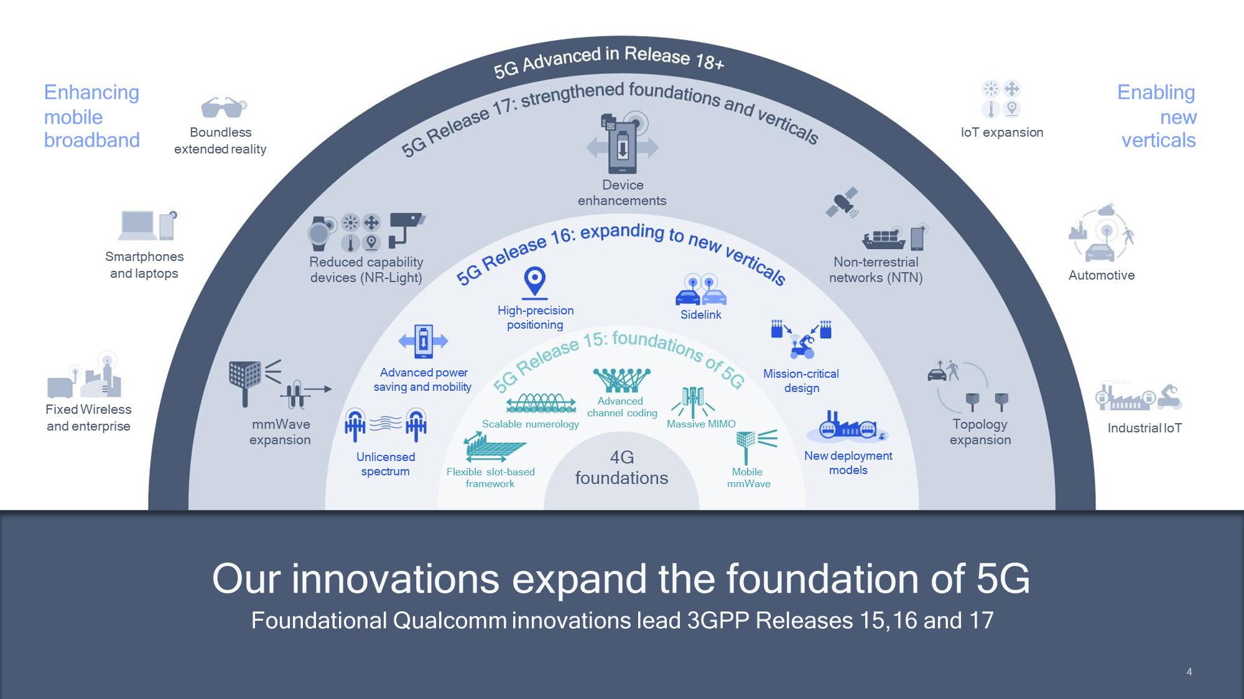
New Radio (NR) Interface: Overview and Features

Slide 14
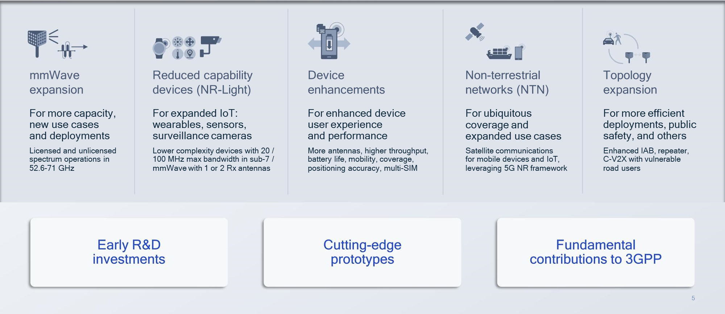
New Radio (NR) Interface: Overview and Features

Slide 15
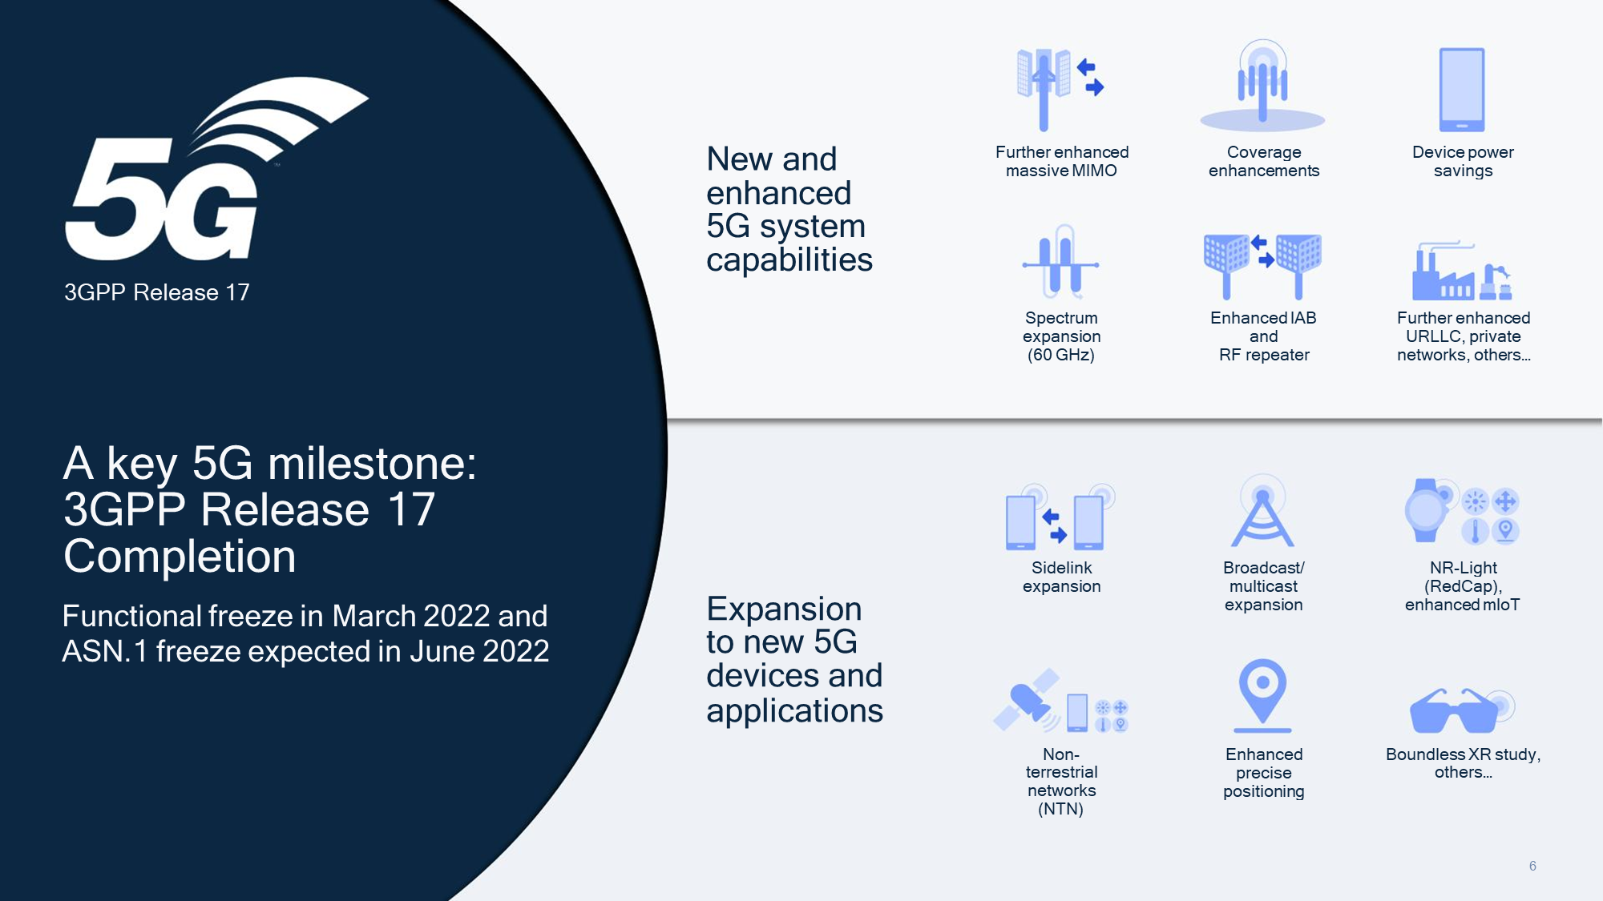
New Radio (NR) Interface: Overview and Features

Slide 16
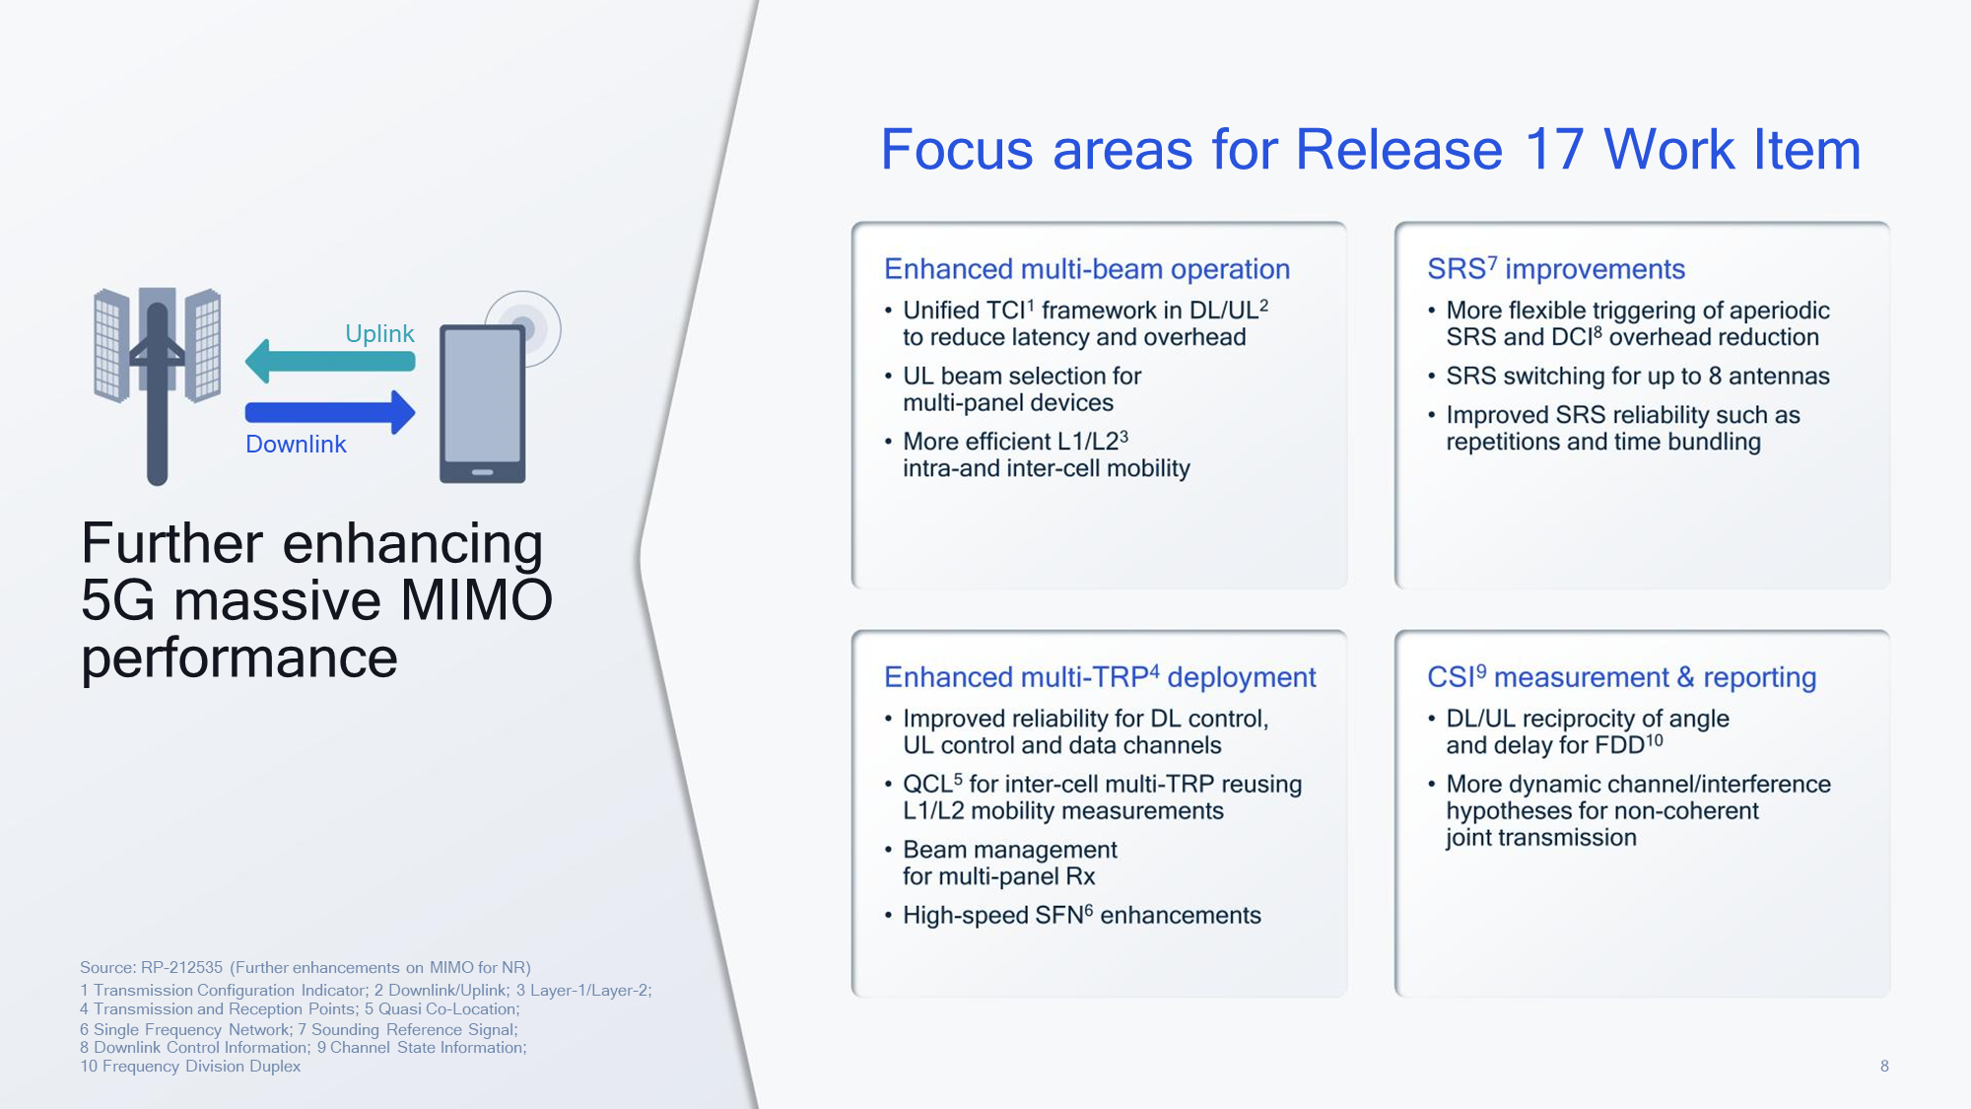
New Radio (NR) Interface: Overview and Features
SRS: Sounding Reference Signal
DCI: Downlink Control Information

Slide 17
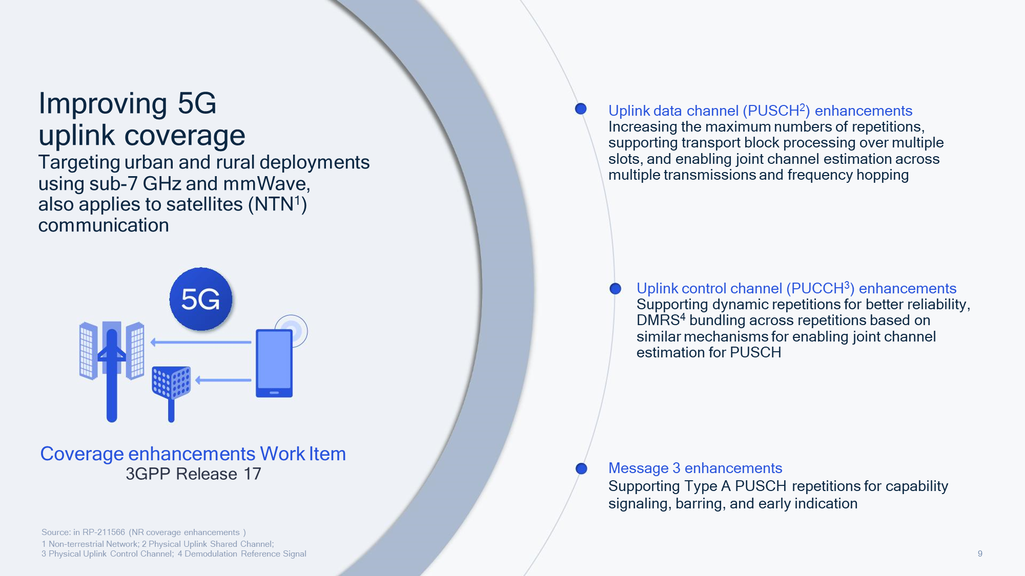
New Radio (NR) Interface: Overview and Features

Slide 18
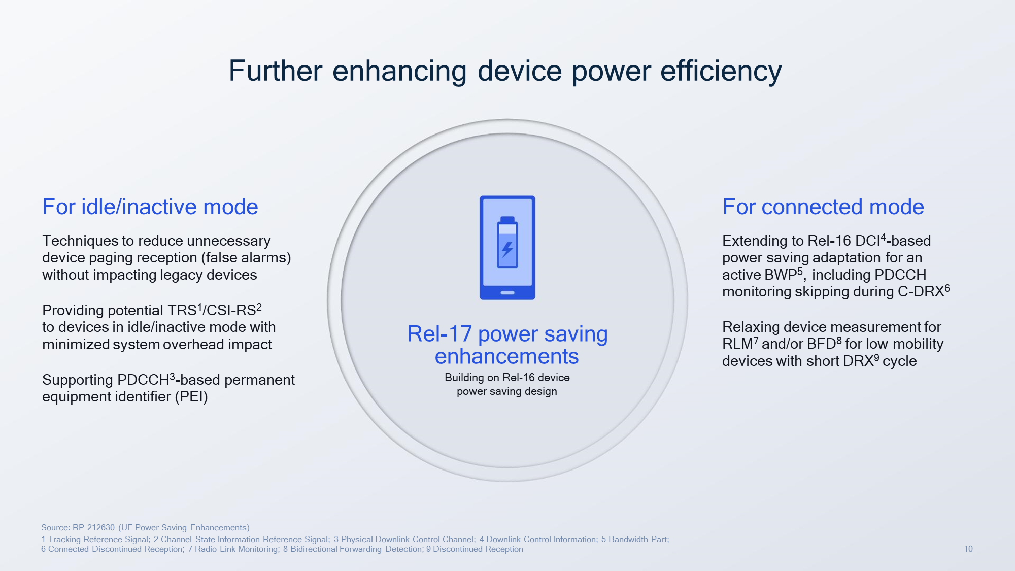
New Radio (NR) Interface: Overview and Features

Slide 19
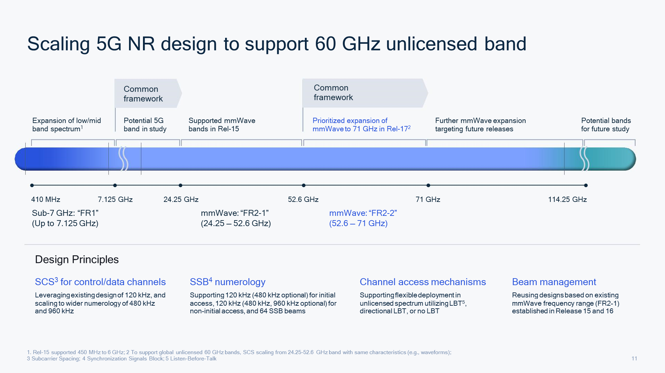
New Radio (NR) Interface: Overview and Features

Slide 20
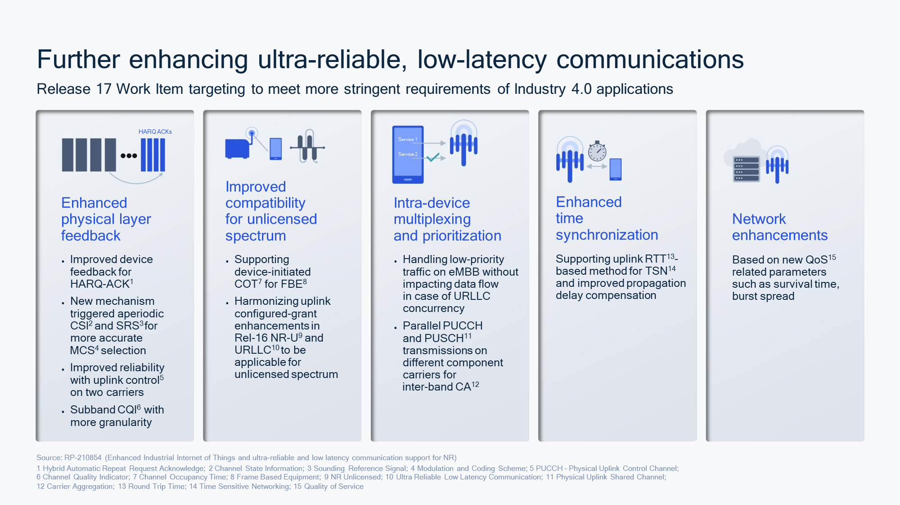
New Radio (NR) Interface: Overview and Features

Slide 21
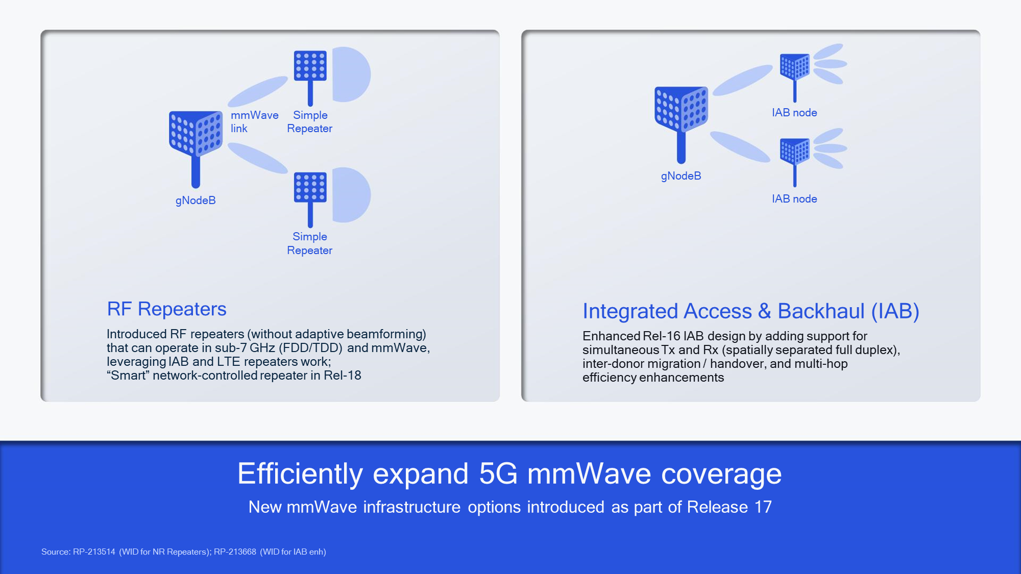
New Radio (NR) Interface: Overview and Features

Slide 22
!!THANK YOU!! !! Have a Nice Day!!
Today we learned about Introduction to Radio Access Technologies &
New Radio (NR) Interface: Overview and Features

Slide 23
MODULE 3: Radio Access Technologies in 5G
M3 S3
New Radio (NR) Interface: Key Technologies

Slide 24
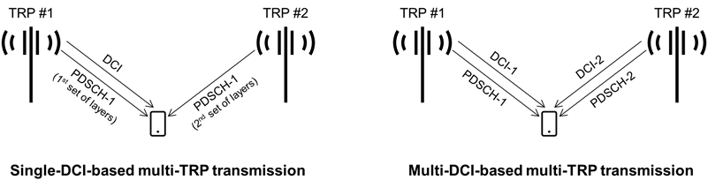
New Radio (NR) Interface: Key Technologies
Single-DCI-based vs. multi-DCI-based multi-TRP transmission
Carrying the information to schedule (allocate physical resources) for Downlink Data (PDSCH)
Carrying the information to schedule (allocate physical resources) for Uplink Data (PUSCH)

Slide 25
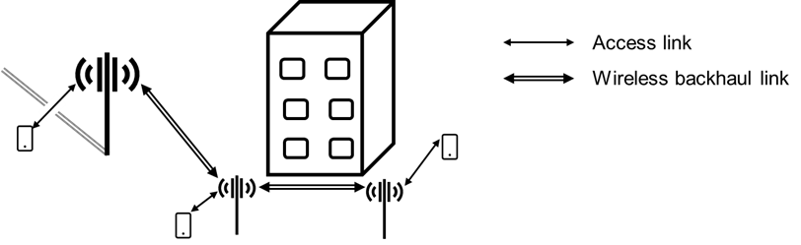
New Radio (NR) Interface: Key Technologies
Integrated Access Backhaul (IAB)

Slide 26
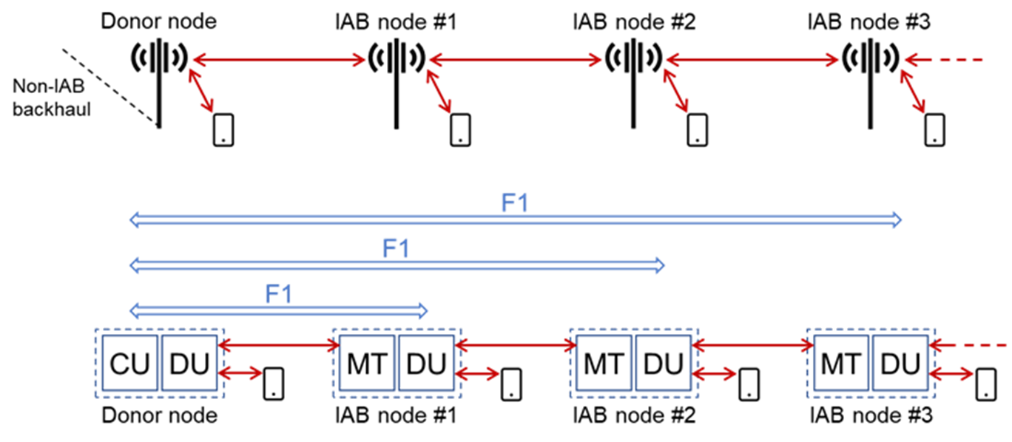
New Radio (NR) Interface: Key Technologies
Types of Network Nodes

Slide 27
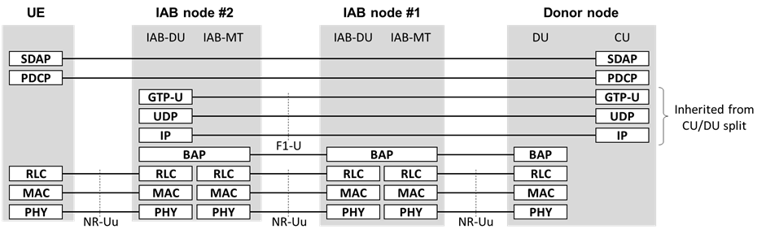
New Radio (NR) Interface: Key Technologies
IAB protocol stack – U-plane

Slide 28
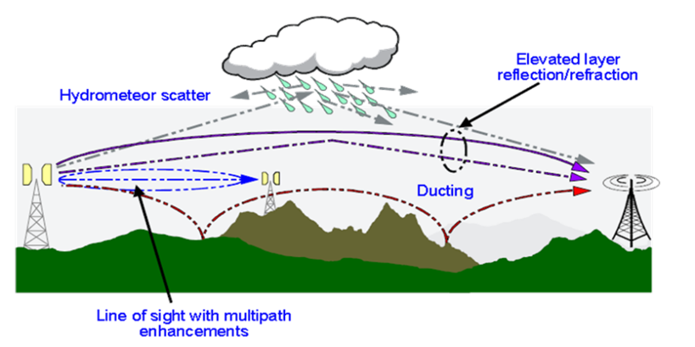
New Radio (NR) Interface: Key Technologies
Remote interference 100's of kms away caused by ducting

Slide 29
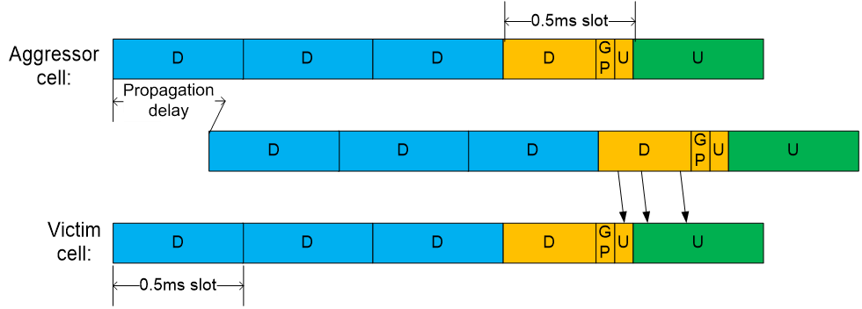
New Radio (NR) Interface: Key Technologies
Single of aggressor cell arriving delayed at victim cell such that downlink of aggressor cell interferes with uplink of victim cell

Slide 30
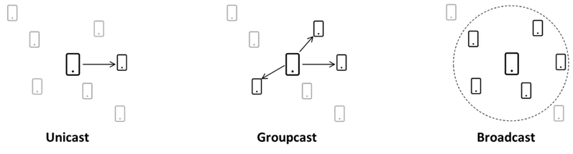
New Radio (NR) Interface: Key Technologies
Basic sidelink transmission scenarios

Slide 31
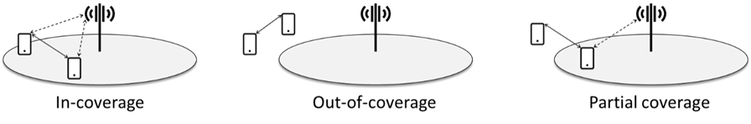
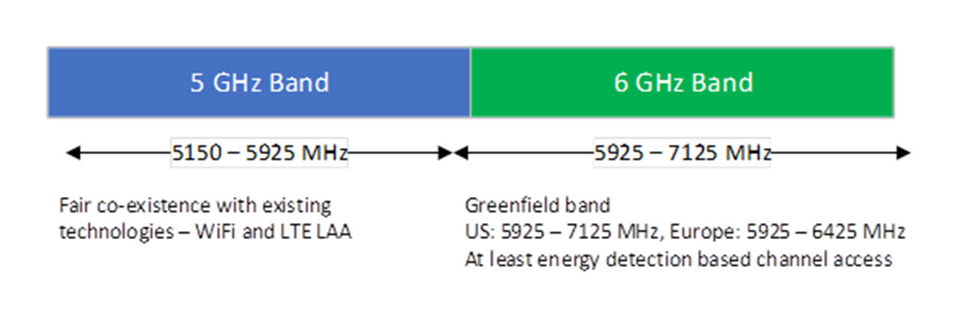
New Radio (NR) Interface: Key Technologies
Sidelink deployment scenarios
Spectrum priorities for NR-U

Slide 32
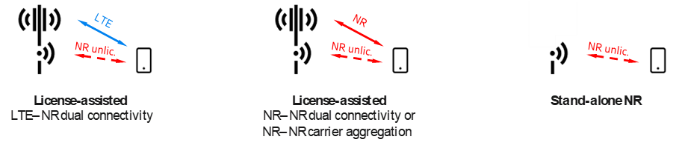
New Radio (NR) Interface: Key Technologies
License-assisted (left and middle) and stand-alone (right) operation of NR in unlicensed spectra

Slide 33
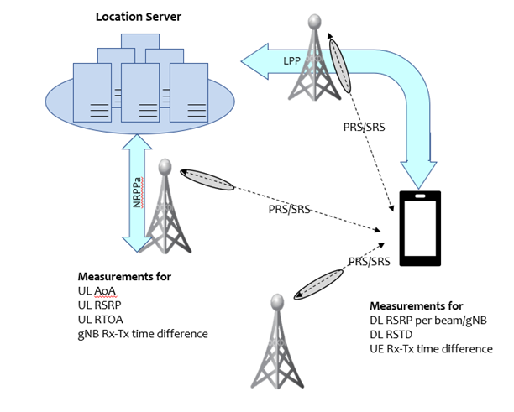
New Radio (NR) Interface: Key Technologies
NR RAT-dependent positioning schemes

Slide 34
MODULE 3: Radio Access Technologies in 5G
M3 S4 & S5
Massive MIMO in 5G Beamforming in 5G

Slide 35
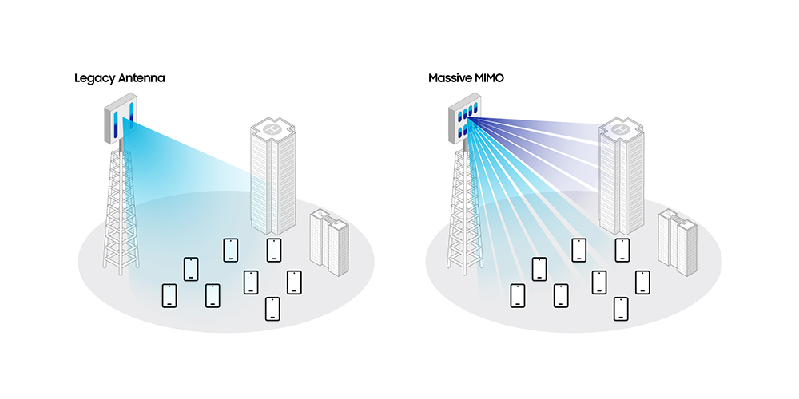
Massive MIMO in 5G

Slide 36

Massive MIMO in 5G
Massive MIMO is a multi-user MIMO (multiple-input multiple-output) technology that can provide uniformly good service to wireless terminals in high-mobility environments.
The key concept is to equip base stations with arrays of many antennas, which are used to serve many terminals simultaneously, in the same time-frequency resource.
The word “massive” refer to the number of antennas and not the physical size.

Slide 37

Massive MIMO in 5G
MIMO systems require a combination of antenna expansion and complex algorithms.
It’s multifaceted, but MIMO has been used in wireless communications for a long time now — it’s common for both mobile devices and networks to have multiple antennas to enhance connectivity and offer better speeds and user experiences.
MIMO algorithms come into play to control how data maps into antennas and where to focus energy in space.
Both network and mobile devices need to have tight coordination among each other to make MIMO work.
Now, with the design of new 5G NR networks, MIMO becomes “massive” and crucial for 5G NR deployments..

Slide 38
Massive MIMO in 5G
Massive MIMO — which is an extension of MIMO — expands beyond the legacy systems by adding a much higher number of antennas on the base station.
The “massive” number of antennas helps focus energy, which brings drastic improvements in throughput and efficiency.
Along with the increased number of antennas, both the network and mobile devices implement more complex designs to coordinate MIMO operations.
That’s all to say, these advancements are all aimed at achieving performance improvements needed to underpin the 5G experiences consumers expect in this new era.

Slide 39
Massive MIMO in 5G
Minimum Antenna Height = ??
For efficient radiation and reception, the height of transmitting and receiving antennas should be comparable to a quarter of wavelength of the frequency used.
So for efficient transmission of signals of wavelengths λ the minimum length of antenna should be λ/4.
Find out the minimum antenna height
F= 3 GHz
F= 6 GHz
F= 60 GHz
F= 90 GHz

Slide 40
Massive MIMO in 5G
What is the distance between each antenna in the MIMO = ??
The most important thing in MIMO antenna design we have take care about the mutual coupling, So, the antennas structure has to be small enough to accommodate the space between the two patches with distances between them of about λ/2 (λ is the free space wavelength),.
So for efficient transmission of signals of wavelengths λ the minimum space between the two patches of antenna should be λ/2.
Find out the minimum space between the two patches of antenna height
Two antenna of F= 3 GHz
Two antenna of F= 6 GHz
One antenna of F= 6 GHz & Other one is of F= 3 GHz

Slide 41
Massive MIMO in 5G
Find out the minimum dimension (in terms of area) of an antenna unit which uses 9 antenna unit of 3GHz frequency and 3 antenna unit of 9GHz frequency??

Slide 42
Massive MIMO in 5G
Benefits of massive MIMO
Increased Network Capacity
Network Capacity is defined as the total data volume that can be served to a user and the maximum number of users that can be served with certain level of expected service. Massive MIMO contributes to increased capacity first by enabling 5G NR deployment in the higher frequency range in Sub-6 GHz (e.g., 3.5 GHz); and second by employing MU-MIMO where multiple users are served with the same time and frequency resources.
Improved Coverage
With massive MIMO, users enjoy a more uniform experience across the network, even at the cell’s edge – so users can expect high data rate service almost everywhere. Moreover, 3D beamforming enables dynamic coverage required for moving users (e.g., users traveling in cars or connected cars) and adjusts the coverage to suit user location, even in locations that have relatively weak network coverage.
User experience
Ultimately, the above two benefits result in a better overall user experience — users can transfer large data files or download movies, or use data-hungry apps on the go, wherever life takes them.

Slide 43
Beamforming in 5G

Slide 44
Beamforming in 5G
Beamforming is another key wireless technique that utilizes advanced antenna technologies on both mobile devices and networks’ base stations to focus a wireless signal in a specific direction, rather than broadcasting to a wide area.
Think of the difference between using a flashlight — which kind of floods everyone in the room — versus a laser pointer, which can pinpoint and continuously track a given user.

Slide 45
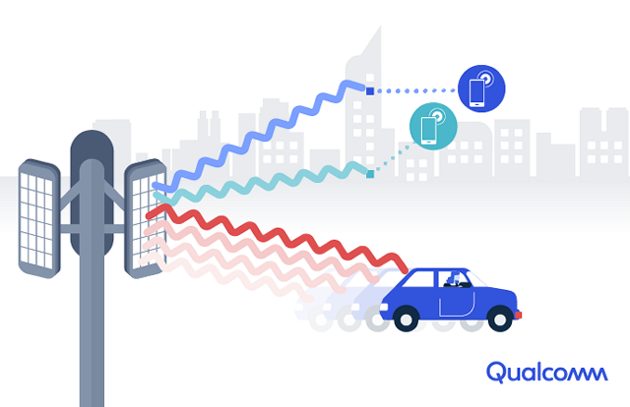
Beamforming in 5G
With the massive number of antenna elements in a massive MIMO system, beamforming becomes “3D Beamforming.”
3D Beamforming creates horizontal and vertical beams toward users, increasing data rates (and capacity) for all users — even those located in the top floors of high-rise buildings (see illustration below).

Slide 46
Beamforming in 5G
Mobile feedbacks to the network, allow the network’s beam to find any point in space, so a mobile user can always be served by a focused beam to their devices, as they are moving on the street or between different floors in a building.
Also having such narrow, direct beams reduces interference between beams directed in different directions.

Slide 47

Beamforming in 5G
Benefits of beamforming
Beamforming effectively uses the science of electromagnetic interference to enhance the precision of 5G connections, working in tandem with MIMO to improve throughput and connection density of 5G network cells.
The resultant highly directional transmissions are particularly beneficial with mmWave transmissions, which suffer heavily from path loss and do not propagate well through obstacles such as walls. The improved Signal-to-Noise Ratios (SNR), enabled by beamforming, increase signal range for both outdoors and - importantly - indoor coverage.

Slide 48
Beamforming in 5G
Benefits of beamforming
Beamforming’s ability to cancel out or “null” interference is also a significant benefit in crowded, urban environments with high densities of UEs, where multiple signal beams can potentially interfere with each other.
Overall, by reducing internal and external interference and reducing SNR, beamforming supports higher-order signal modulation schemes, such as 64QAM and 16QAM - all of which contribute to a substantial improvement in network cell capacity.

